Slide 1

Literary History
5V
November 2023, December 2023, January 2024
Test in Testweek 2

Slide 2
Literary Periods
Old English Period
500-1066
Middle English Period
1066-1500
Renaissance
1500-1660
The Regency
1811-1820
Romantic Period
1798-1870
Age of Reason
Enlightenment
1660-1800
Victorian Period
1830-1900

Slide 3
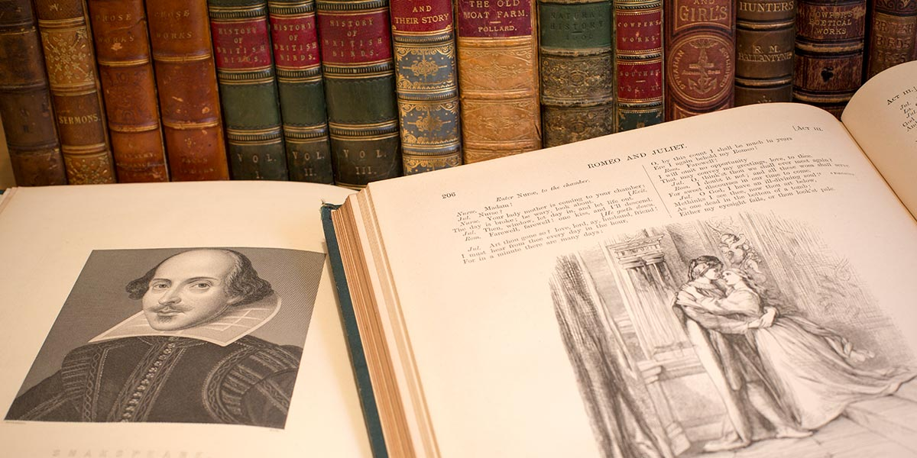
The Renaissance
1500-1660

Slide 4
The Renaissance
1500-1660
History
Starts late 15th, early 16th century (Tudor dynasty from 1485, Henry VII)
Came over from Italy and rest of Europe
Literary characteristics
Renewed interest in Ancient Roman and Greek cultures (seen as pagan in Middle Ages)
Antropomorphic (man-centred) instead of theocentric (god-centred)
Individual attitude instead of collective
Critical investigation instead of dogmatic belief
Rise of the printing press
Literary Works
  Plays by William Shakespeare, such as Romeo & Juliet, Macbeth, Hamlet, etc
  Sonnets by William Shakespeare, such as Sonnet 18: Shall I compare thee to a summer’s day
  John Milton’s Paradise Lost
  Edmund Spenser’s The Fairie Queene
  Christopher Marlowe’s Doctor Faustus

Slide 5


Slide 6
Shakespearean Sonnet
The term "sonnet" is derived from the Italian word sonetto (lit. "little song”). By the 13th century it signified a poem of fourteen lines that followed a strict rhyme scheme and structure.
Sonnet came to England in the 16th century
Shakespeare wrote 154 sonnets (+ some used in his plays)
English/Shakespearean sonnet:
  Length: 14 lines
  Rhyme: three alternately rhymed quatrains (four-line stanzas) terminating in a final couplet (ABAB CDCD, EFEF, GG)
  Meter: iambic pentameter

Slide 7
Shakespearean Sonnet
Iambic Pentameter:
An iambic foot is an unstressed syllable followed by a stressed syllable.
The rhythm can be written as:
da DUM
A standard line of iambic pentameter is five iambic feet in a row:
da DUM da DUM da DUM da DUM da DUM

Slide 8
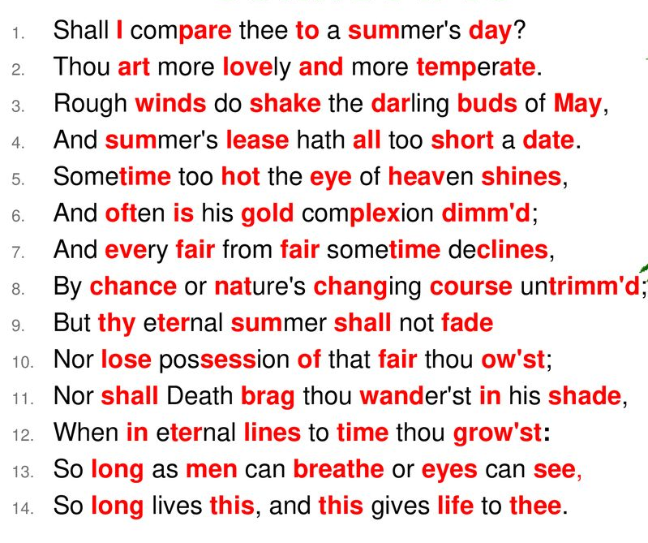
Sonnet 18

Slide 9
The Renaissance
1500-1660
William Shakespeare’s Sonnet 18: Shall I compare thee to a summer’s day
Answer the questions on Shakespeare’s Sonnet 18 in your reader

